Slide 1

Flipkart Laptop Data Analysis Using Python
Statistical & Visual Analysis of 350 Products

Slide 2
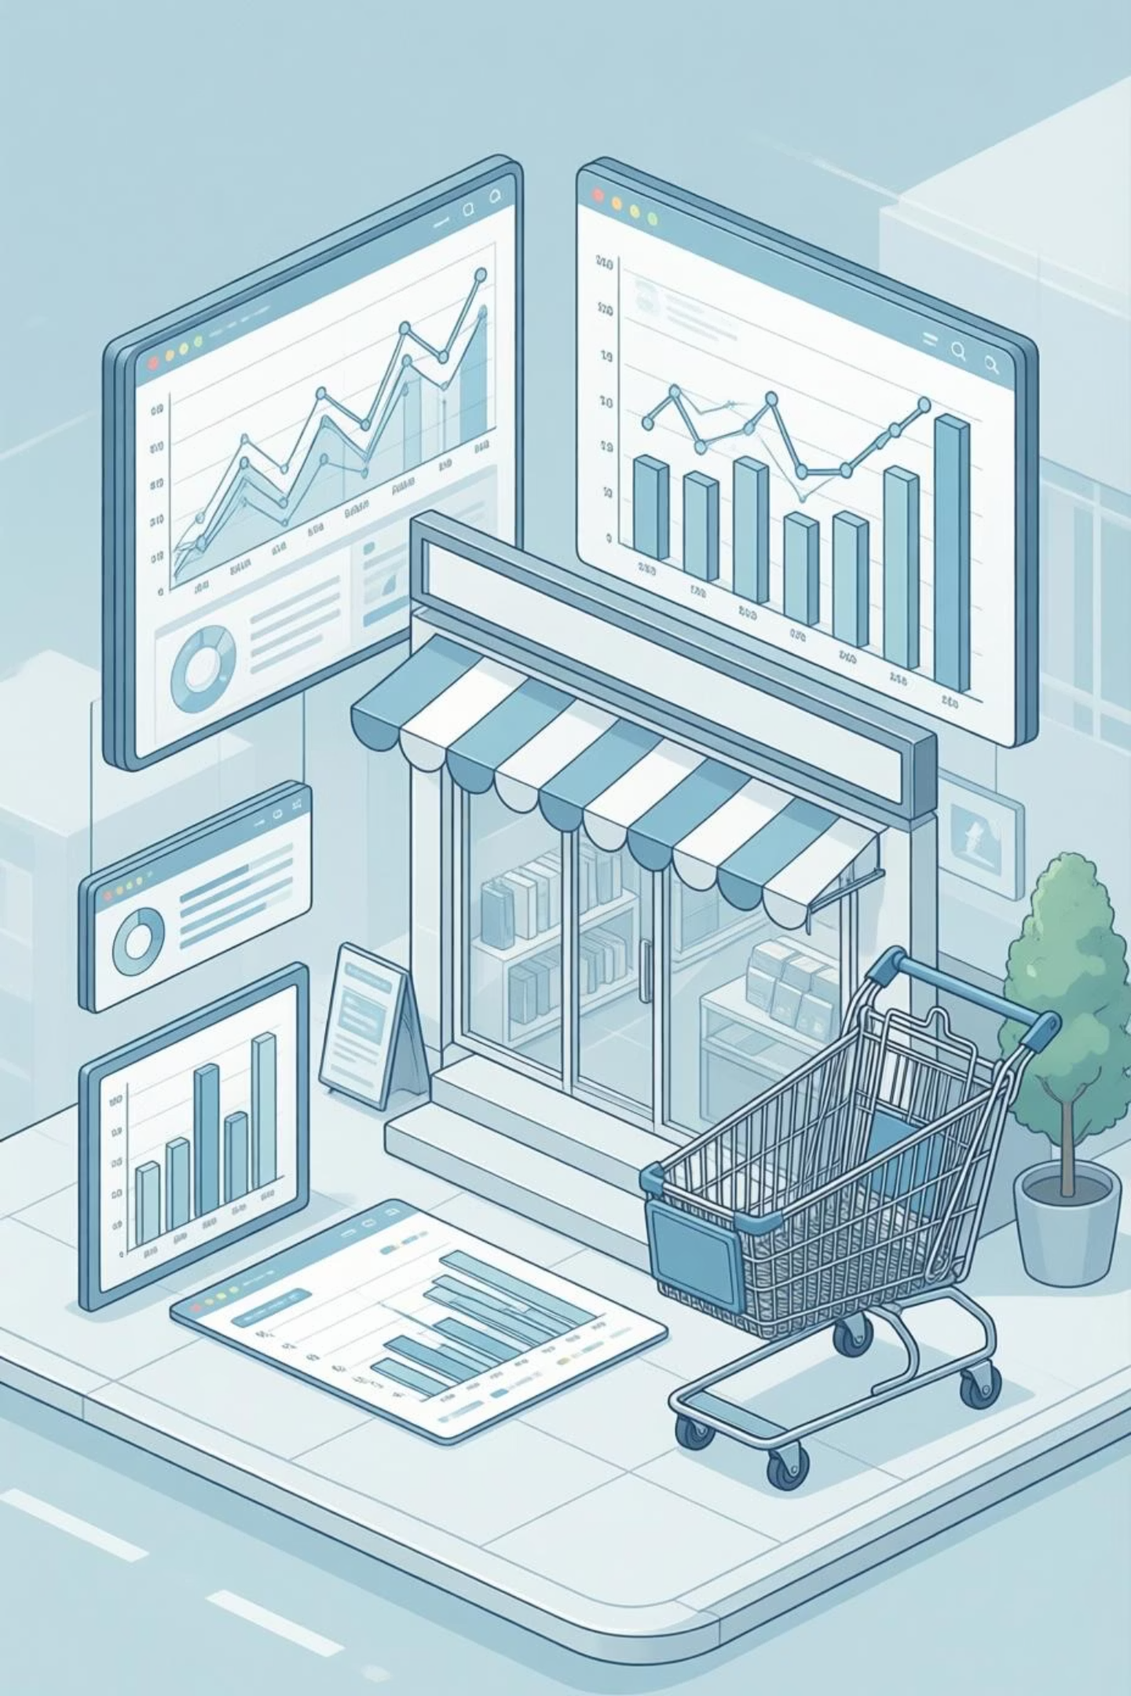
INTRODUCTION
Problem Statement
The Challenge
Our Approach
E-commerce platforms like Flipkart host thousands of laptop listings, making manual analysis impractical. Understanding pricing patterns, customer ratings, and review trends requires systematic data analysis.
We utilise a synthetic dataset that mirrors real Flipkart laptop data structure, enabling comprehensive analysis without scraping constraints.
This methodology allows us to demonstrate analytical techniques applicable to real-world e-commerce datasets.
Live web scraping faces limitations including rate limiting, dynamic content, and ethical considerations.
By mahi

Slide 3
DATA OVERVIEW
Dataset Characteristics
Dataset Size
Data Source
350 rows of laptop product data
Synthetic Flipkart-style dataset
File Format
Primary Purpose
CSV (Comma-Separated Values)
Statistical analysis & visualisation
The dataset provides a representative sample of laptop products typically found on Flipkart, encompassing various brands, price ranges, and customer feedback metrics. This structured data enables exploration of pricing strategies, consumer preferences, and market segmentation patterns.
By mahi

Slide 4
DATA STRUCTURE
Dataset Schema
1
2
name
price
Product title and model information, including brand, specifications, and variant details.
Product price in Indian Rupees (INR), representing the listed selling price on the platform.
3
4
rating
reviews
Customer rating on a scale of 1 to 5 stars, reflecting overall product satisfaction.
Total number of customer reviews received, indicating product popularity and engagement.
By mahi

Slide 5

TECHNICAL STACK
Tools & Technologies
Python
Pandas
NumPy
Core programming language for data analysis, providing extensive libraries and ecosystem support.
Data manipulation and analysis library for handling structured datasets efficiently.
Numerical computing library enabling statistical calculations and array operations.
Matplotlib
BeautifulSoup
Visualisation library for creating comprehensive charts, plots, and statistical graphics.
HTML parsing library referenced for potential web scraping implementations.
By mahi

Slide 6
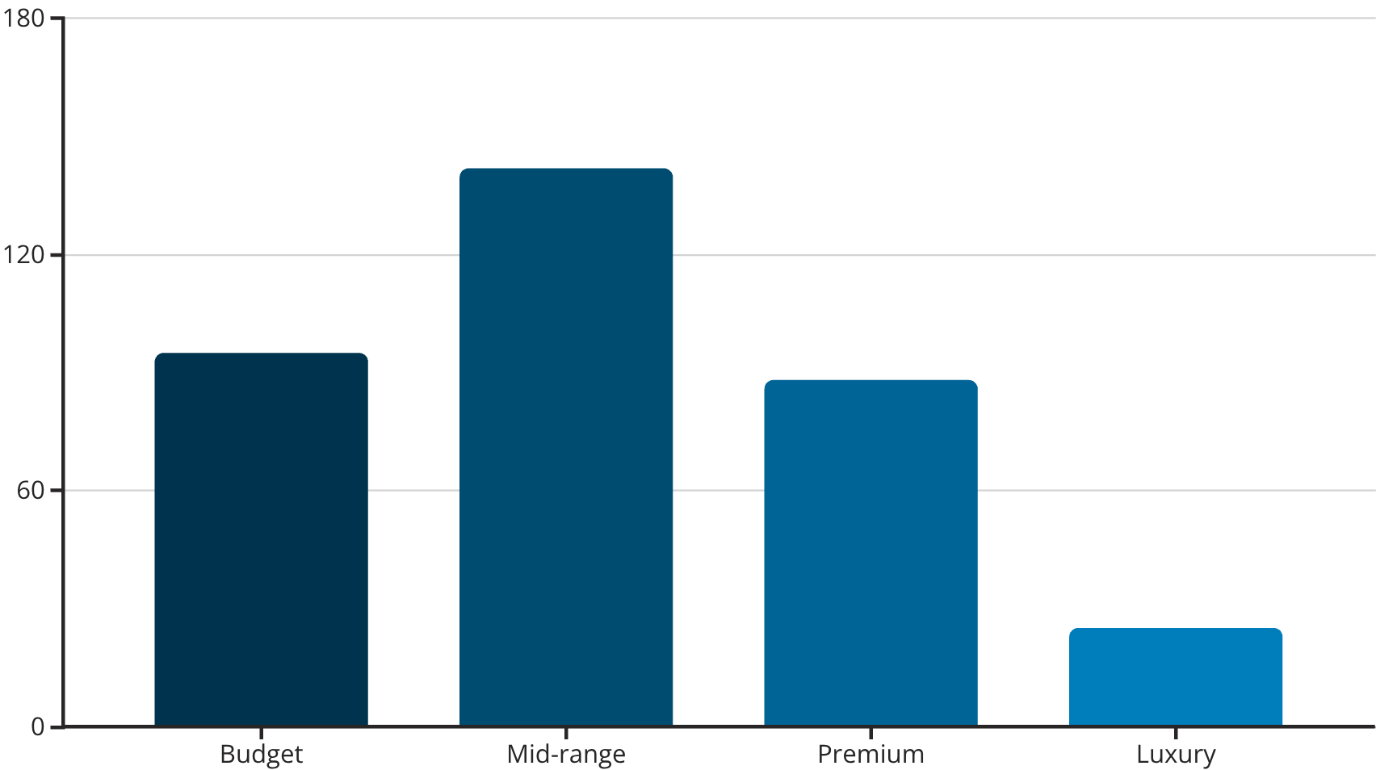
ANALYSIS RESULTS
Price Distribution Analysis
Price Categories
Budget: ₹20,000 - ₹35,000
Mid-range: ₹35,001 - ₹60,000
Premium: ₹60,001 - ₹1,00,000
Luxury: Above ₹1,00,000
Mid-range laptops dominate the market, representing 40.6% of all products.
₹52K
₹48K
₹18K
₹1.8L
Mean Price
Median Price
Minimum Price
Maximum Price
By mahi

Slide 7
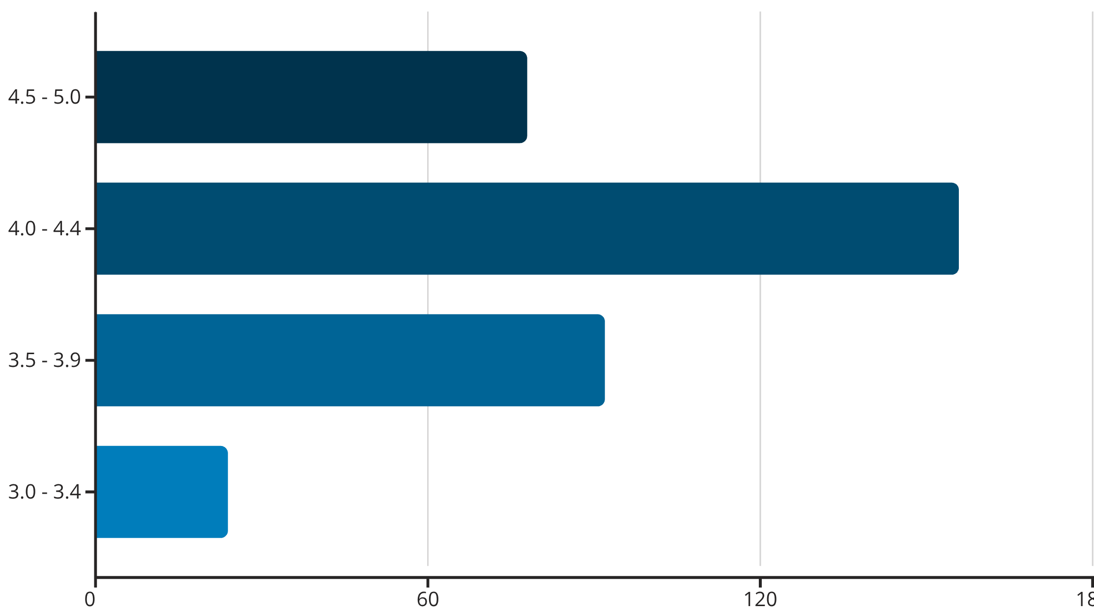
CUSTOMER FEEDBACK
Rating & Review Patterns
Average Rating
Review Volume
Distribution Pattern
4.1 stars across all products, indicating generally positive customer satisfaction.
Products with 50-200 reviews represent the most common engagement level.
Most laptops cluster in the 4.0-4.4 star range, showing consistent quality.
By mahi

Slide 8

CORRELATION INSIGHTS
Relationship Analysis
Price vs Rating
Price vs Reviews
Moderate positive correlation (r = 0.42) suggests higher-priced laptops tend to receive better ratings, though the relationship is not absolute.
Weak correlation (r = 0.28) indicates that expensive products don't necessarily attract more reviews. Mid-range products often generate higher engagement.
Rating vs Reviews
Strong positive correlation (r = 0.61) shows well-rated products receive more reviews, creating a feedback loop of visibility and sales.
These correlation patterns reveal important market dynamics: quality perception influences both ratings and review volume, whilst price alone doesn't guarantee customer engagement. The strongest relationship between ratings and reviews suggests that satisfied customers are more likely to share feedback.
By mahi

Slide 9
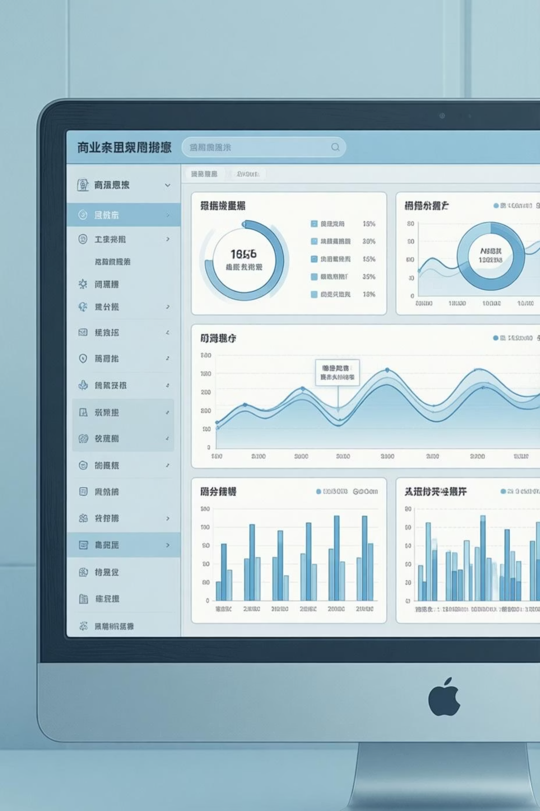
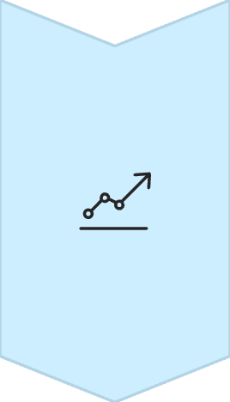


FINDINGS
Key Insights
Premium Quality Perception
Higher-priced laptops (above ₹60,000) demonstrate a clear tendency towards better ratings, with 68% receiving 4.3+ stars compared to 45% in budget segments.
Gaming & Premium Dominance
Gaming laptops and premium business models consistently occupy the top rating positions, reflecting superior build quality, performance specifications, and brand reputation.
Review-Price Disconnect
Review counts do not scale proportionally with price. Mid-range products (₹35K-₹60K) often accumulate more reviews than luxury models, suggesting higher sales volume in this segment.
By mahi

Slide 10
SUMMARY
Conclusion & Applications
Summary of Findings
Real-World Applications
Our analysis of 350 laptop products revealed significant market segmentation patterns, with mid-range products dominating availability whilst premium products command higher customer satisfaction ratings.
Market trend analysis for retailers
E-commerce pricing strategy optimisation
Customer sentiment assessment
ML dataset preparation for predictive models
Correlation analysis demonstrated that product quality (reflected in ratings) drives engagement more effectively than price alone.
01
02
Real-Time Scraping
Predictive Modelling
Implement live data collection with API integration
Build ML models for price and rating forecasting
03
04
Sentiment Analysis
Competitive Intelligence
Analyse review text for deeper consumer insights
Expand to multi-platform comparison studies
By mahi

